Slide 1

Delivering Value: A Data‑Driven Story of Shipping Performance & Profitability
235576 | Abdelrahman Almakhzangy
235185 | Nouran Mostafa
233126 | Mariam Ahmed
234791 | Passant Gamil
229214 | Abdelrahman Salah

Slide 2
Overview
Project Context: – Retail orders & inventory data (2015–2017) – 30,871 records, complete dataset
Objectives:
Diagnose shipping delays
Understand inventory costs
Examine sales–profit dynamics and discount effects

Slide 3

Diagnose shipping delays

Slide 4
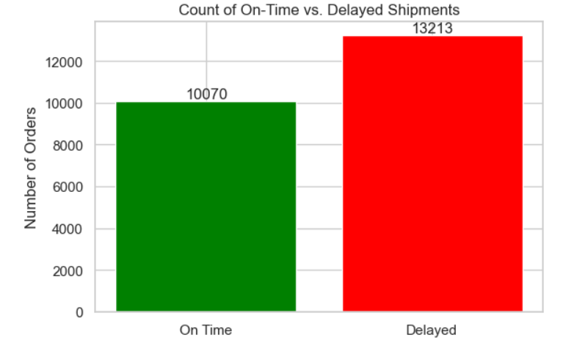
Delays and On-time Comparison

Slide 5
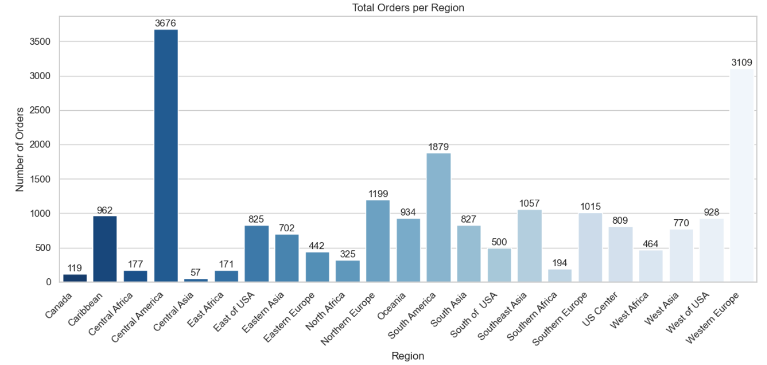
The demand by Region

Slide 6
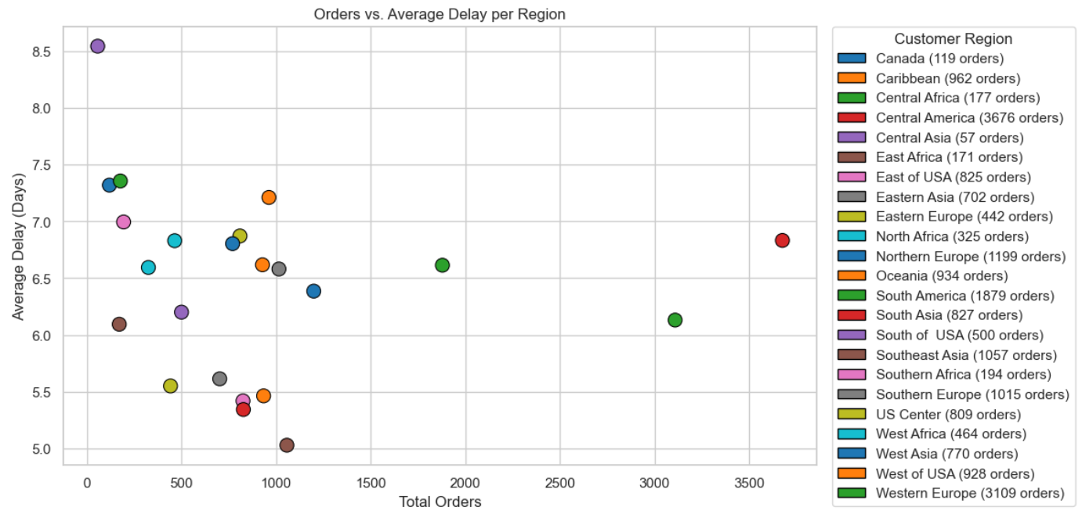
Average delay for each Region

Slide 7
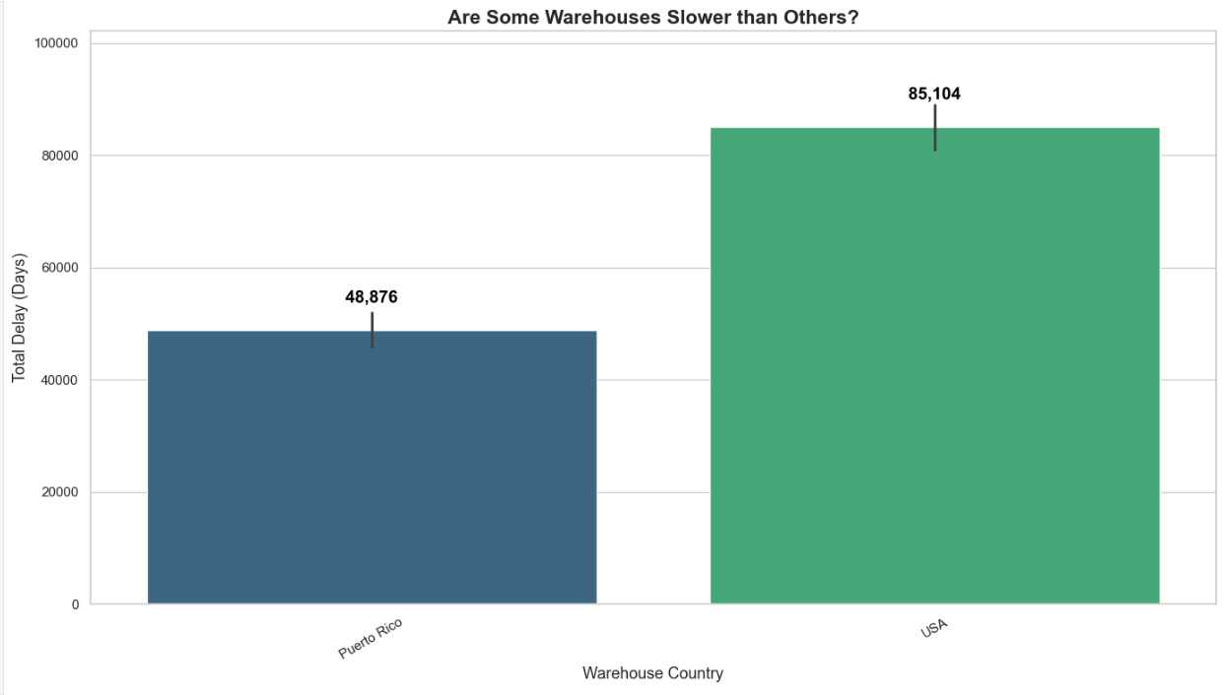
The speed of each warehouse to deliver

Slide 8
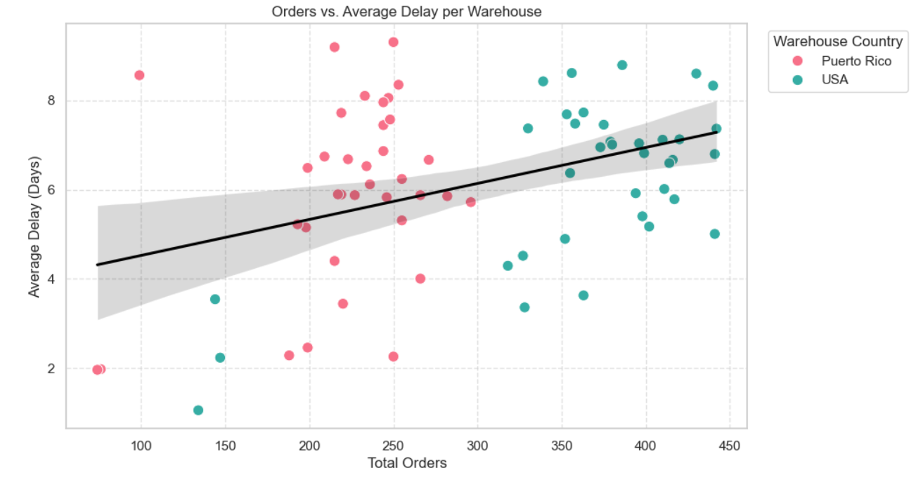
Warehouse and it’s relation to delay

Slide 9
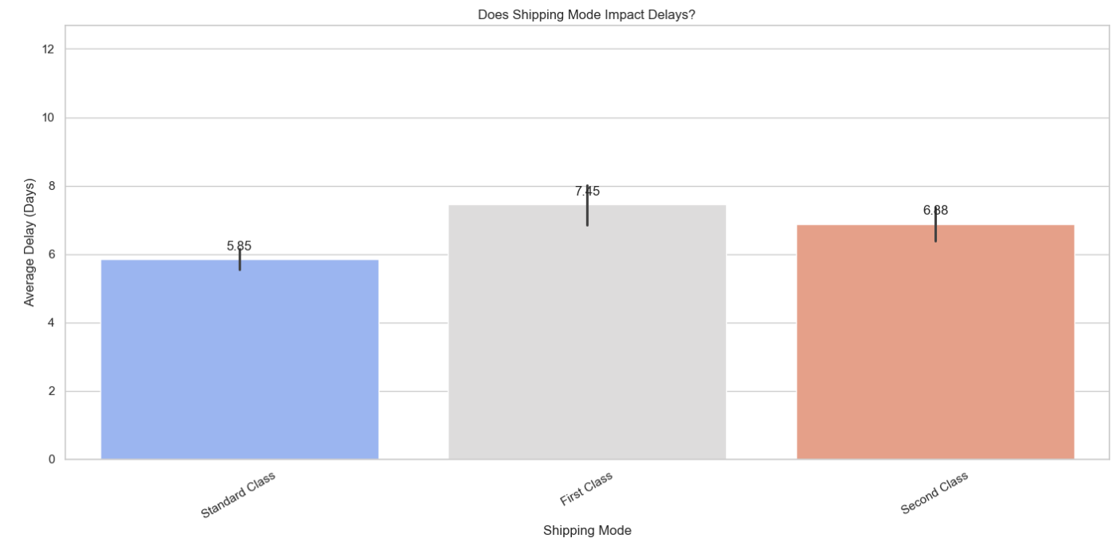
How Shipping modes impact delay

Slide 10
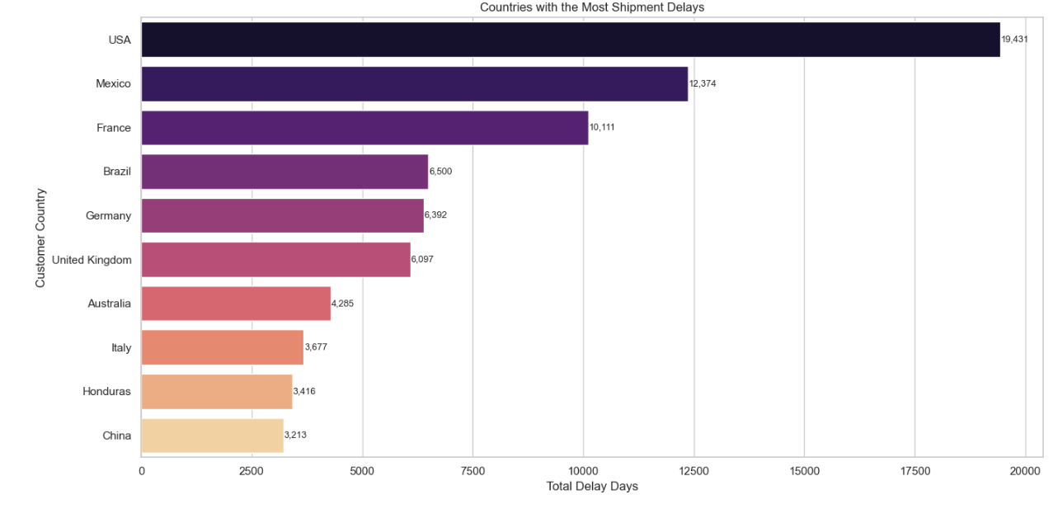
Countries with the highest delay

Slide 11
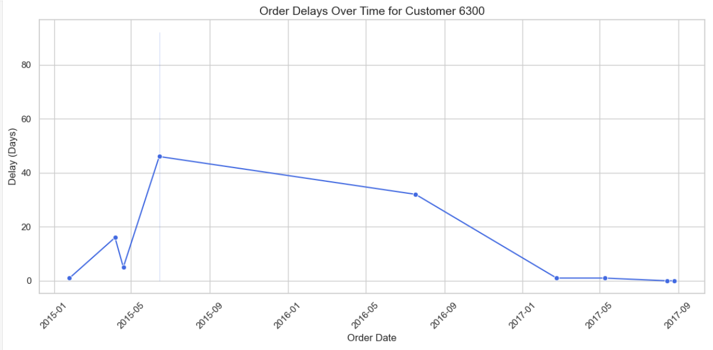
How does delay affect customers

Slide 12
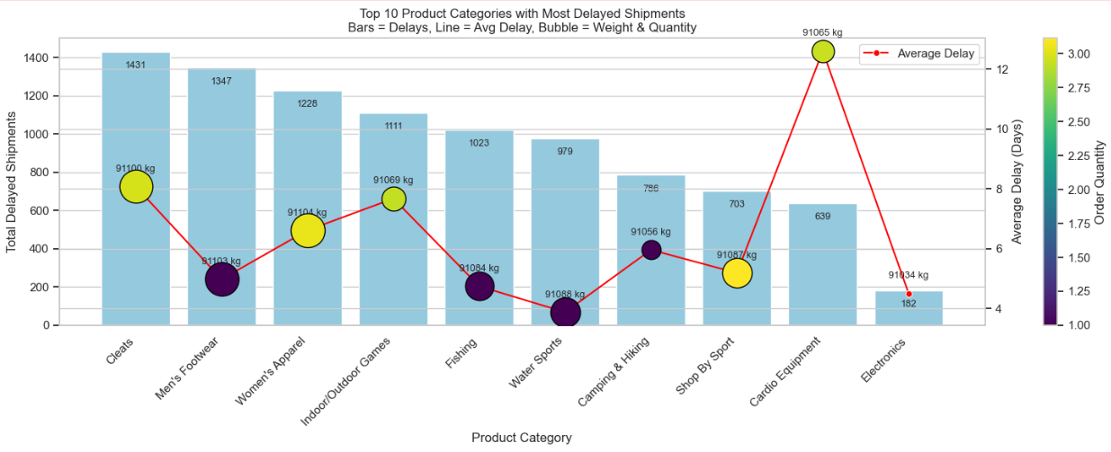
How weight affect delay in relation to category

Slide 13
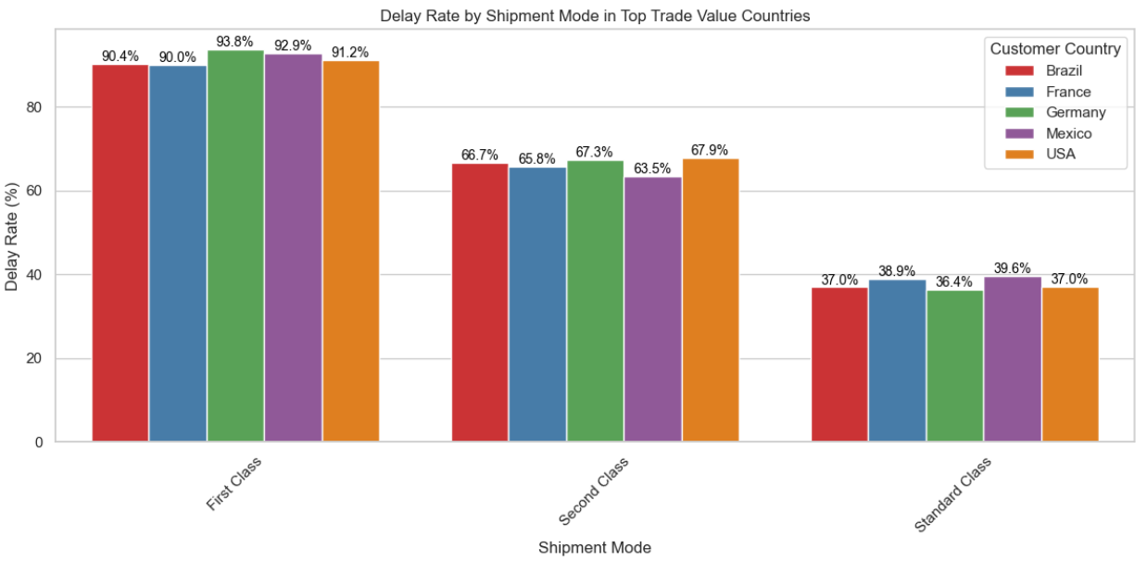
Shipping mode for top trade countries

Slide 14
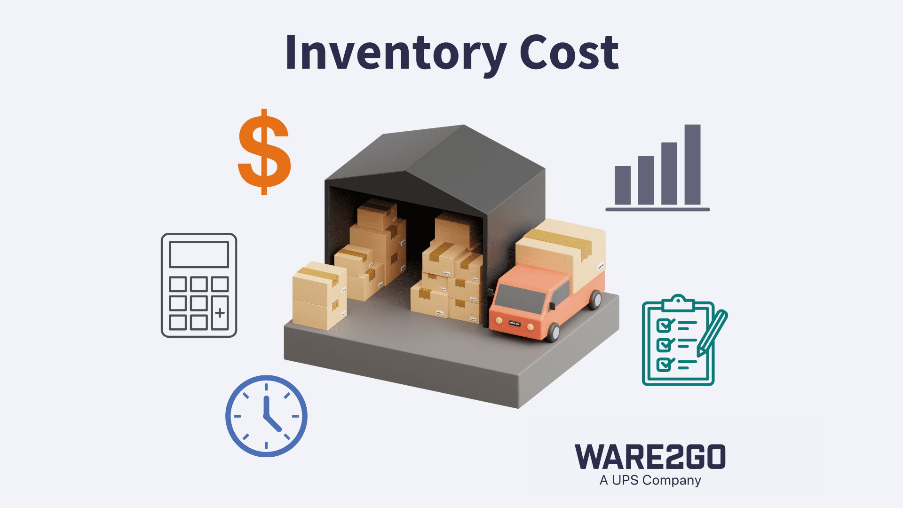
Understand inventory costs

Slide 15
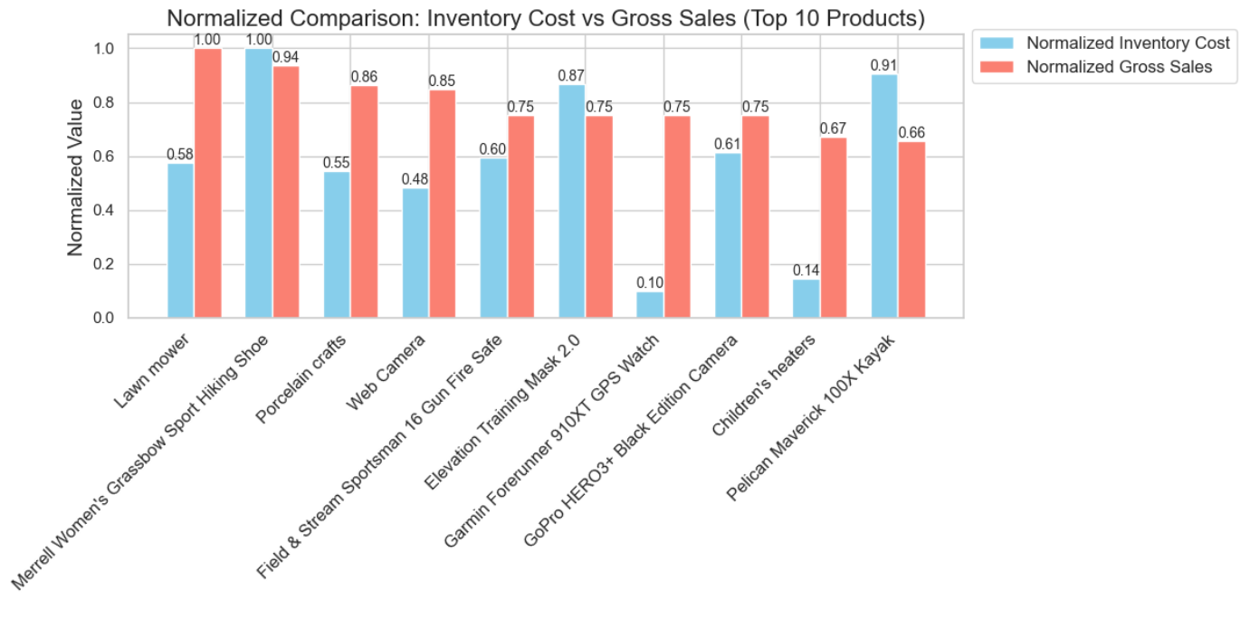
Inventory Cost Vs Gross Sales

Slide 16

Examine sales–profit dynamics and discount effects

Slide 17
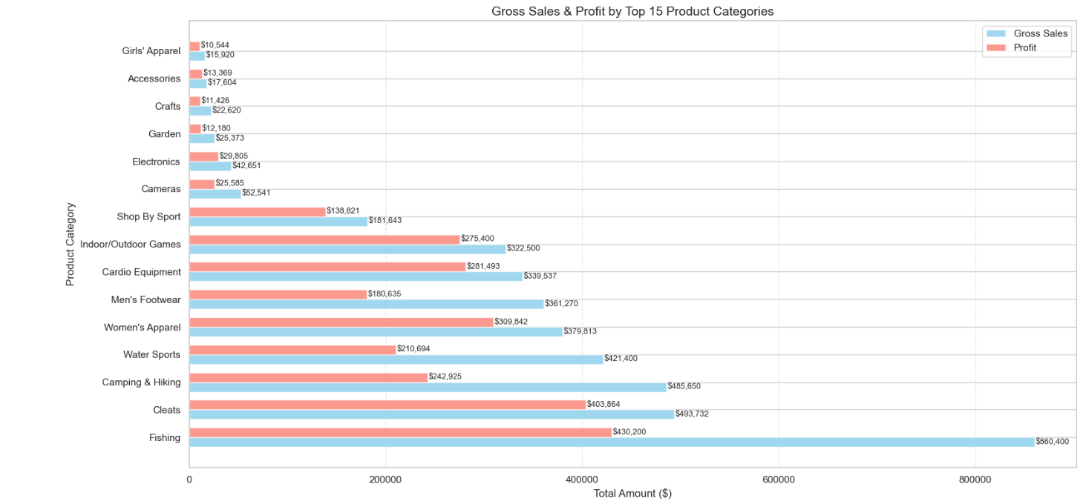
Gross and Profit of top 15 Product Categories

Slide 18
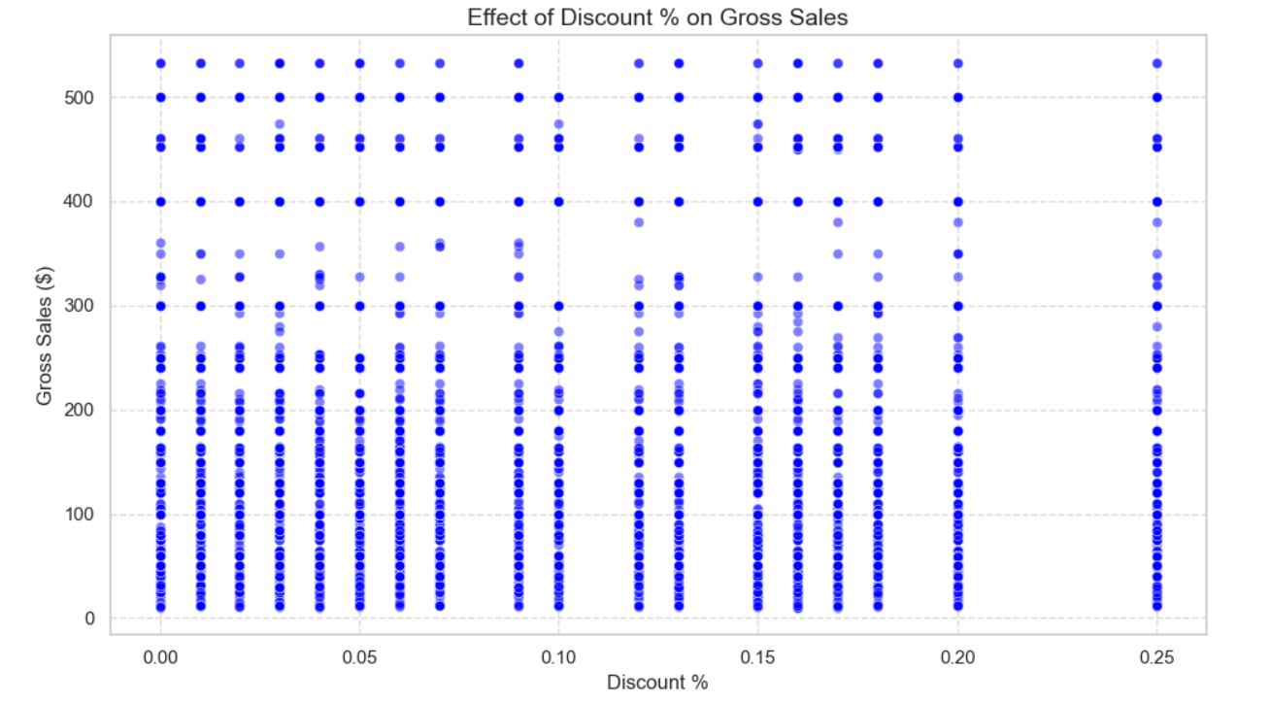
Discount and Gross Sales

Slide 19
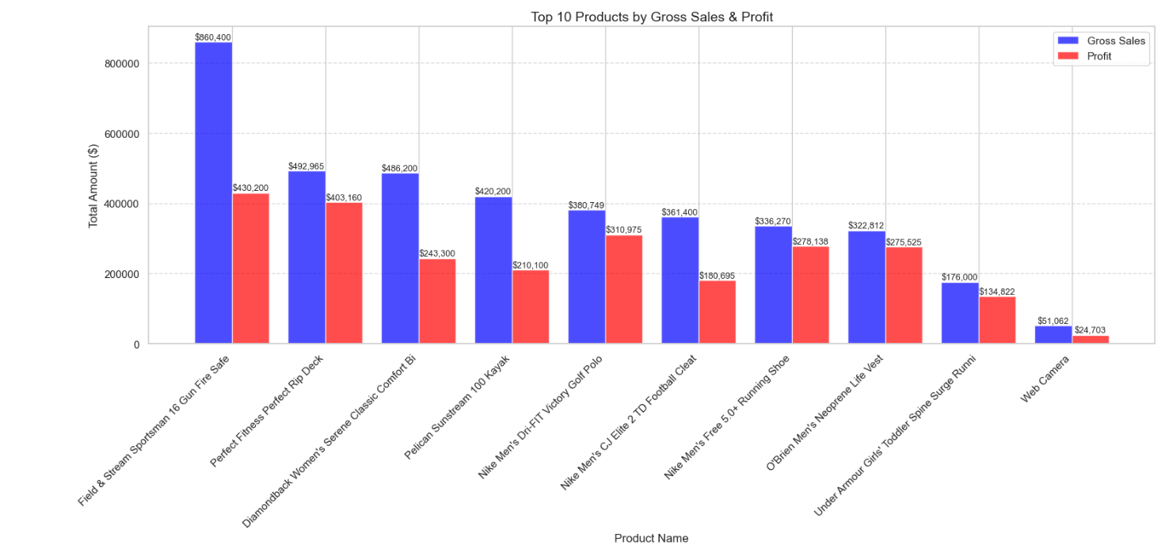
Ranking Products by Gross Sales and Profit

Slide 20
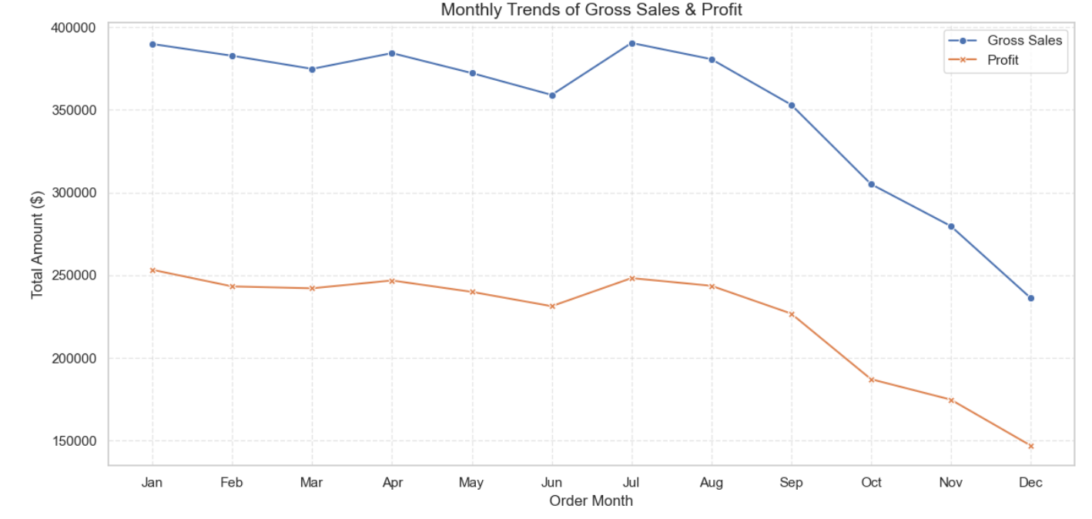
Monthly Trends (2016)

Slide 21
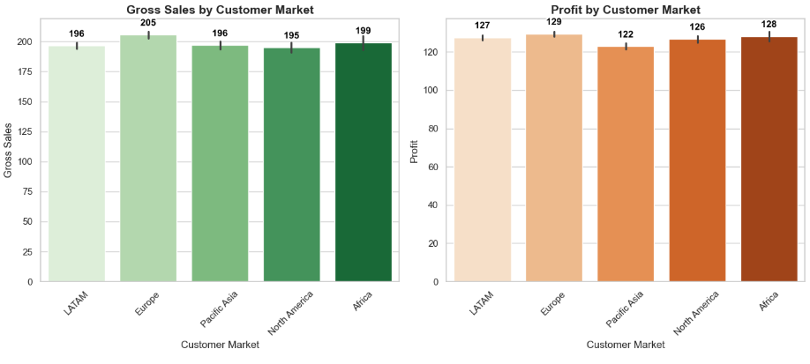
Gross Sales and Profit for each region

Slide 22
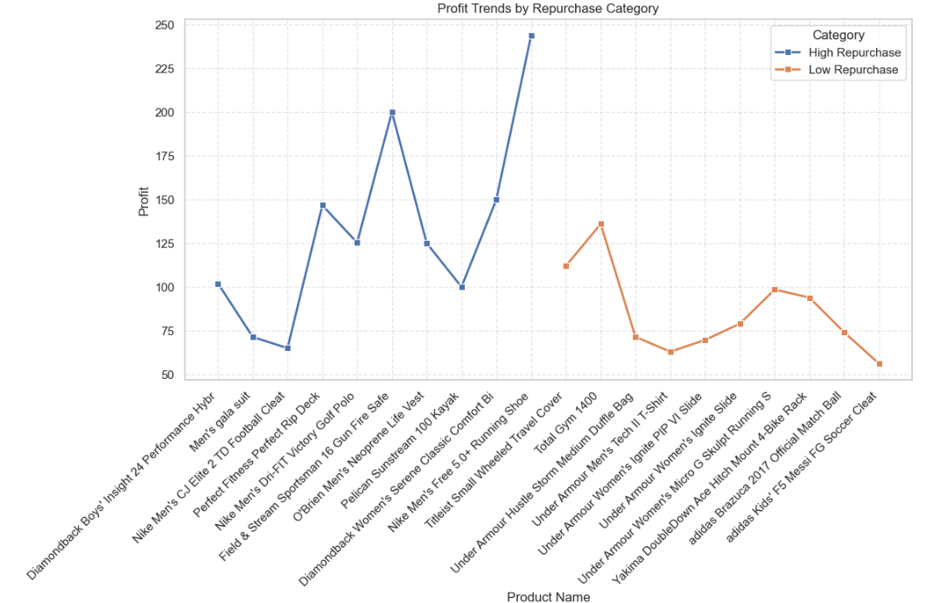
Repurchase Category Profit Trends

Slide 23
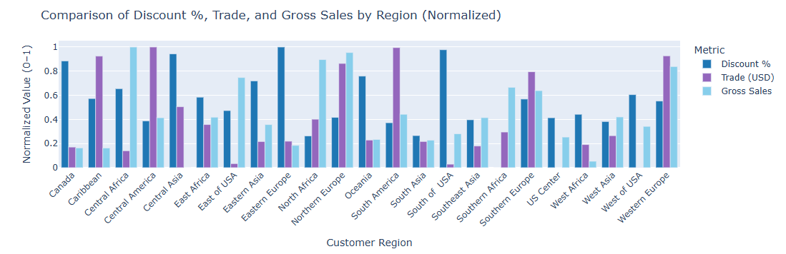
Trade, discount, and gross sales by region

Slide 24
Thank You

